Slide 1

Zomato Analytics Project
Prepared using Excel, Tableau, SQL & Power BI

Slide 2
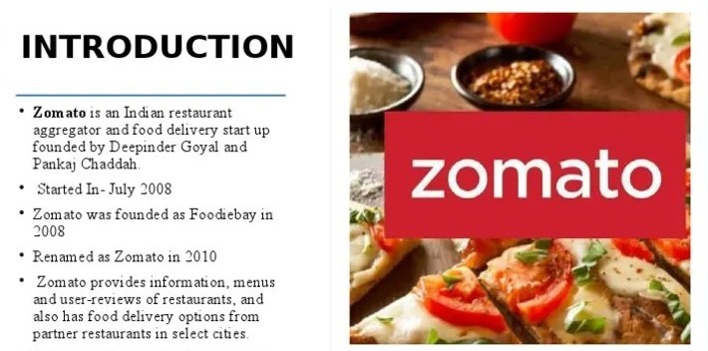



Slide 3
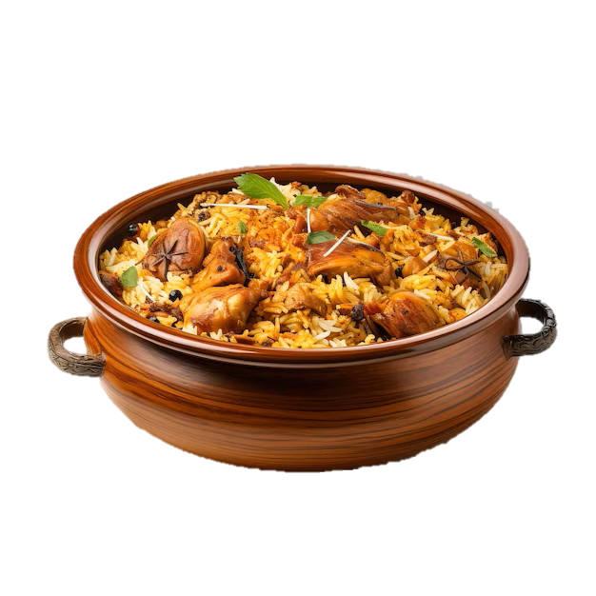
CONTENTS
1. Build a country Map Table
2. Build a Calendar Table using the Column Date-key
Add all the below Columns in the Calendar Table using the Formulas.
(A) .Year
(B) .Month no
(C) .Month full name
(D) .Quarter (Q1,Q2,Q3,Q4)
(E) . Year Month ( YYYY-MMM)
(F) . Week day no
(G) .Week day name
(H) .Financial Month ( April = FM1, May= FM2 …. March = FM12)
(I) . Financial Quarter ( Quarters based on Financial Month)
3. Find the Numbers of Restaurants based on City and Country.
4. Numbers of Restaurants opening based on Year , Quarter , Month
5. Count of Restaurants based on Average Ratings
6. Create buckets based on Average Price of reasonable size and find out how many Restaurants falls in each buckets
7. Percentage of Restaurants based on "Has _ Table _ booking"
8. Percentage of Restaurants based on "Has _ Online _ delivery"
9. Develop Charts based on Cuisines, City, Ratings

Slide 4

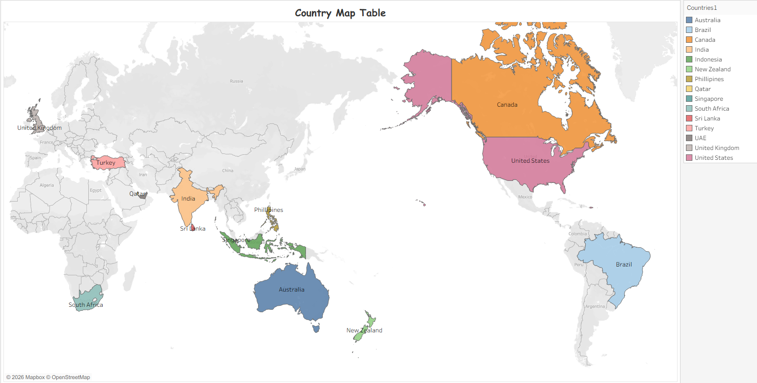
COUNTRY MAP TABLE
=VLOOKUP(C2,Sheet1! A2:B17, 2,False)
A world map highlighting selected countries in different colors, with others shown in grey.
The highlighted countries include United States, Canada, Brazil, United Kingdom, Turkey, India, Sri Lanka, Philippines, Indonesia, Singapore, South Africa, Australia, and New Zealand.
Used in dashboards to visualize and compare country-wise data distribution.

Slide 5

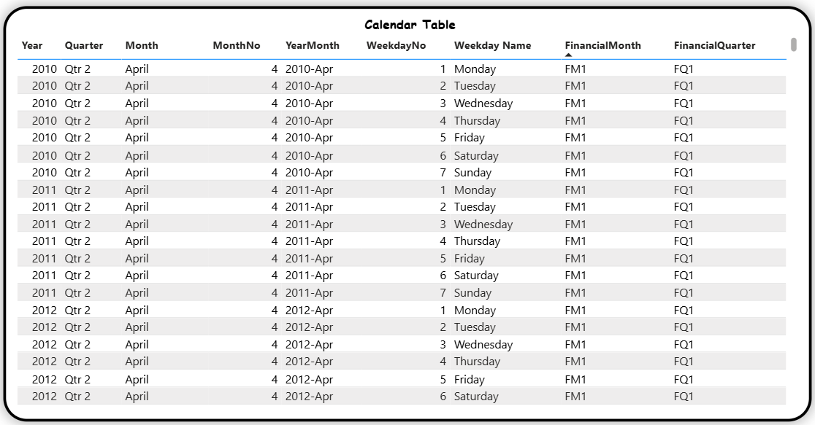
CALENDAR MAP TABLE
Year =YEAR('Raw Data'!T2:T9552)
Month no =MONTH('Raw Data'!T2:T9552)
Month Full Name =TEXT('Raw Data'!T2:T9552,"mmmm")
Quarter =ROUNDUP(MONTH('Raw Data'!T2:T9552)/3,0)
Year Month =DATEDIF('Raw Data'!T2:T9552,'Raw Data'!AB2,"YM")
Week day no =+WEEKNUM('Raw Data'!T2,1)
Week day name =TEXT('Raw Data'!T2:T9552,"dddd")
Financial Month =IF(MONTH('Raw Data'!T2)>=4, MONTH('Raw Data'!T2)-3, MONTH('Raw Data'!T2)+9)
Financial Quarter ="Q"&INT((MOD(MONTH('Raw Data'!T2)-4,12))/3)+1

Slide 6

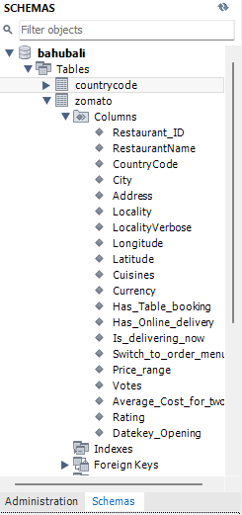
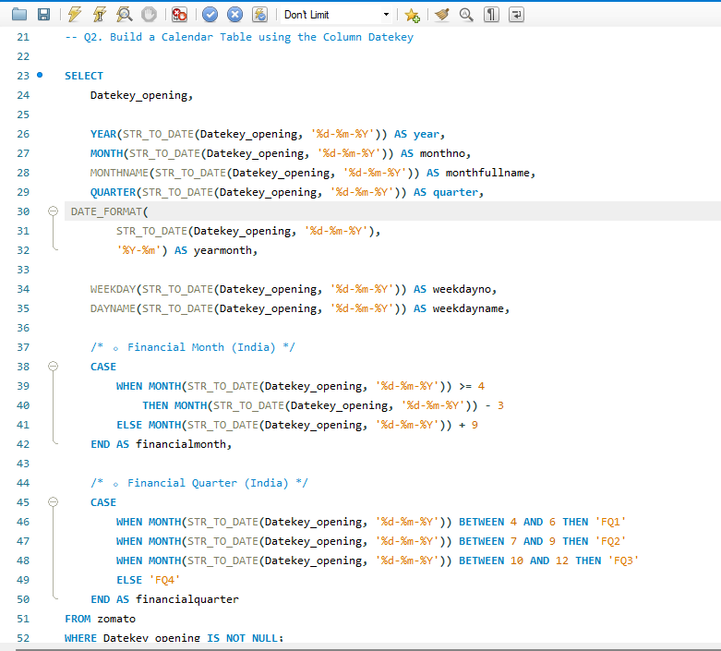
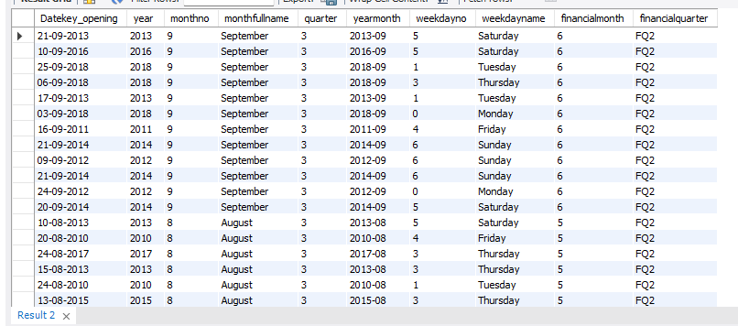
CALENDAR TABLE Script in SQL
The query creates a calendar (date dimension) table from the Date key-opening column in the Zomato dataset.
It converts the date into a proper format and derives useful time attributes such as year, month number, month name, quarter, year–month, weekday number, and weekday name.
It also calculates Indian financial month and financial quarter (April–March).

Slide 7

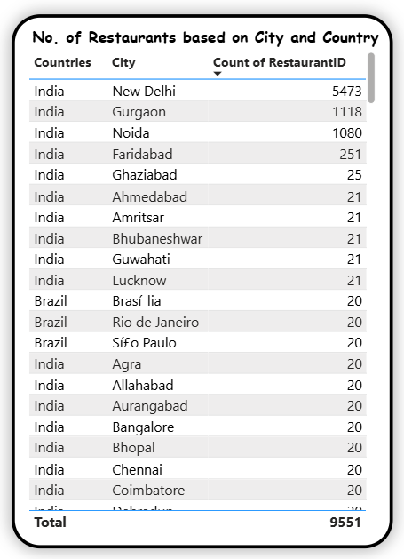
NO.OF RESTAURANTS based on COUNTRY & CITY
City on columns, Restaurant count on rows, sorted descending for quick insights.
It is used to identify high-demand cities
Here we can see Country India with city “New Delhi“ followed by “Gurgaon” and “Noida”, have more restaurants, when compared to other cities.
In this above chart we can see that the overall Count of Restaurants are around “9,551”, in which “New Delhi” has the huge count of “5,473” which is more than 50% of the restaurant count.
Followed by Gurgaon in the 2nd place with the count of “1,118”

Slide 8

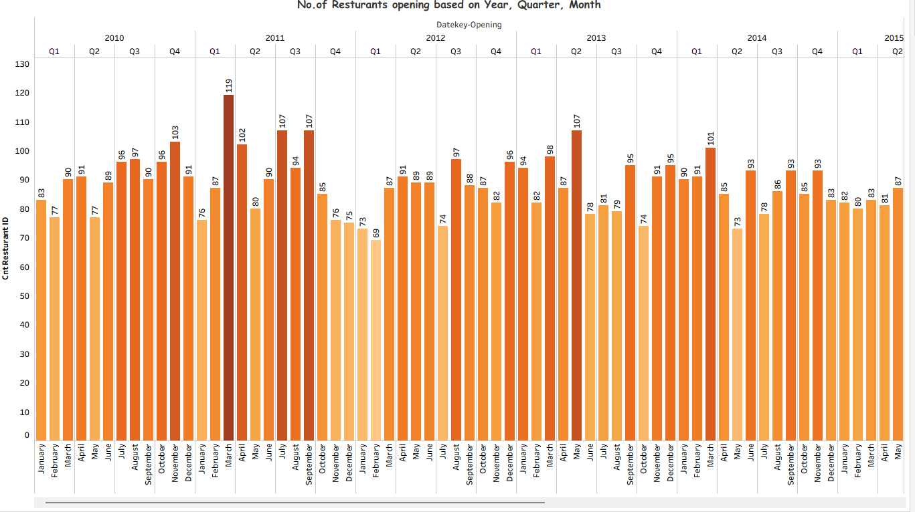
RESTAURANT OPENINGS on YEAR, QUARTER, MONTH
In this chart we have taken Date key-Opening Information in a Stacked bar chart to get the detailed Information of Restaurant Openings Yearly, Quarterly & Month Wise.
Year → Quarter → Month drill-down, This Identifies growth & seasonal patterns.
Date hierarchy created using Calendar Table

Slide 9

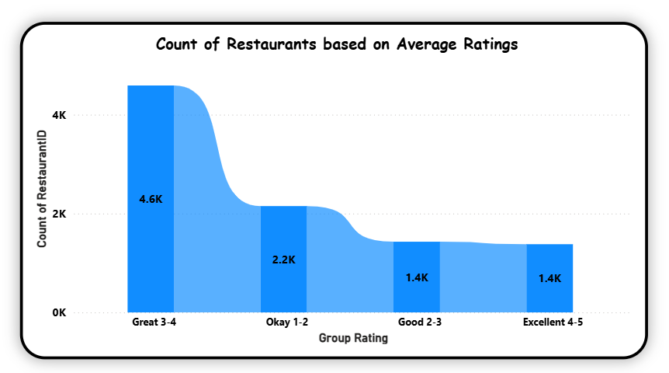
COUNT OF RESTAURANTS based on AVERAGE RATING
=IF(ISNUMBER(S2), LOOKUP(S2, {1,2,3,4,5}, {"Okay 1-2","Good 2-3","Great 3-4","Excellent 4-5", "Excellent 4-5"}), "No Rating")
This Average Rating is Used for quality assessment.
By using the above Formula we have Divided the Average ratings of Restaurant count into 4 categories.
i.e. If the rating is between “0-2” It would be shown as “Okay”, where as if it is under “2-3” rating it is shown as “Good”, same with “3-4” it is shown as “Great” and Finally If it is under “4-5” it is displayed as “Excellent”.
The above chart shows that (“3-4” “Great”) category of rating has the Maximum count of Numbers which is “4.6k” when compared to other Categories.

Slide 10

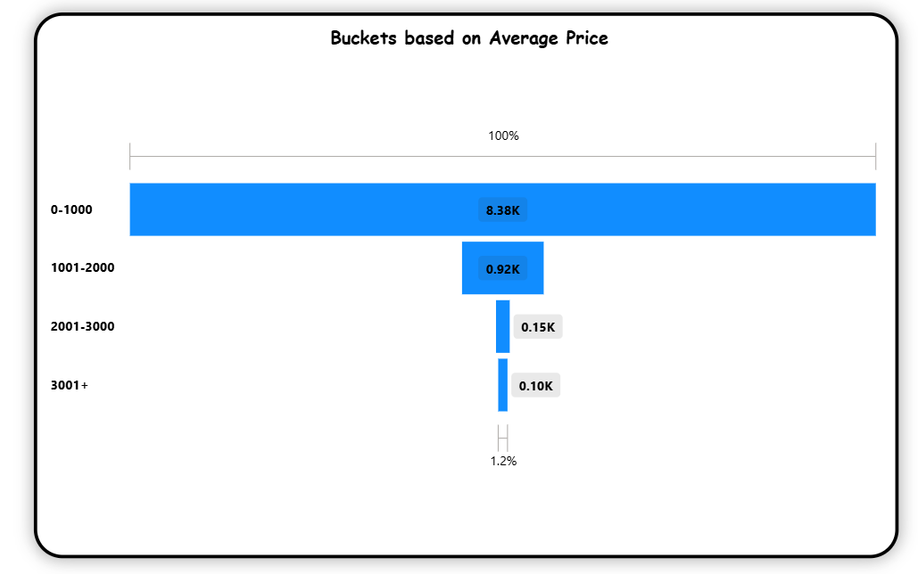
AVERAGE PRICE BUCKET
=IF(ISNUMBER(R2), LOOKUP(R2,{0,1001,2001,3001},{"0-1000","1001-2000","2001-3000","3001+"}), "No Value")
This Average Price Bucket is Used for quality assessment.
By using the above Formula we have Divided the Average Price of reasonable size to find out how many restaurants falls in each buckets.
If the price is between “0-1000” It would be under one Bucket, where as if it is under “1001-2000” price it would fall under other Bucket, same with other 2 if the price is between “2001-3000” and “3001 +” then it would be in different Buckets.
In the above chart we can see that “0-1000” Price Bucket category has the Maximum count of Numbers which is “8.38k” when compared to other Price Buckets.

Slide 11

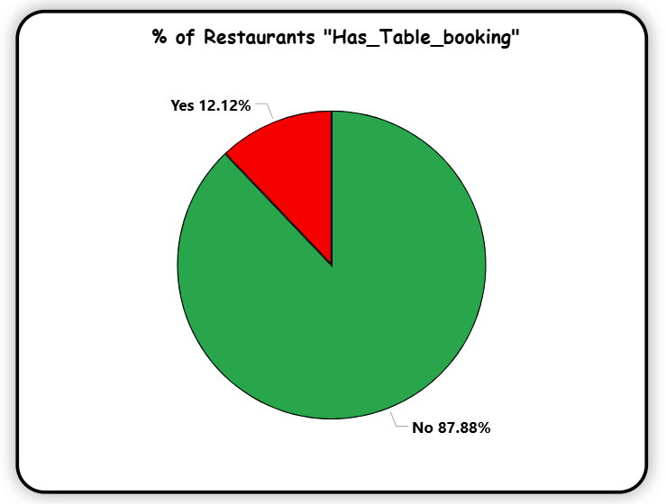
PERCENTAGE OF RESTAURANTs “Has_Table_Booking"
Quick operational capability insight
The above pie chart represents the distribution of Restaurants based on the availability of table booking.
In which “87.88%” of restaurants “Do NOT” provide Table bookings, where as “12.12%” of Restaurants are ”Yes” which provides Table booking Services.
The Green portion indicates “Restaurants without table booking”, while the “Red portion” represents restaurants with Table bookings.

Slide 12

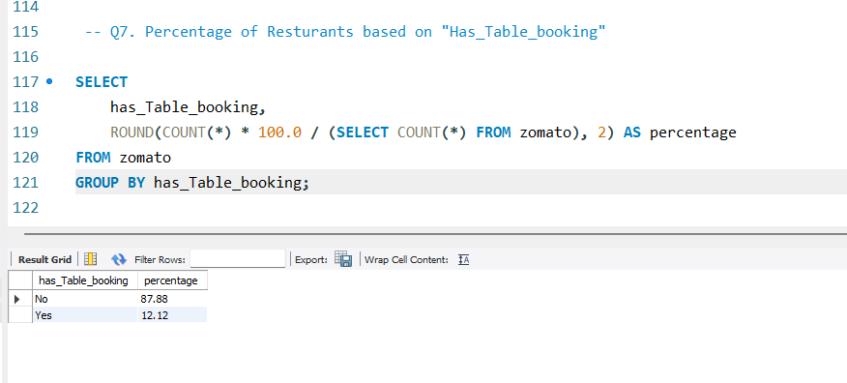
% OF Restaurants on Table Booking Script in SQL
What the query does
Groups all restaurants by whether they have table booking (Yes / No)
Counts how many restaurants fall into each group
Divides each group’s count by the total number of restaurants
Multiplies by 100 and rounds to 2 decimal places to get percentages

Slide 13
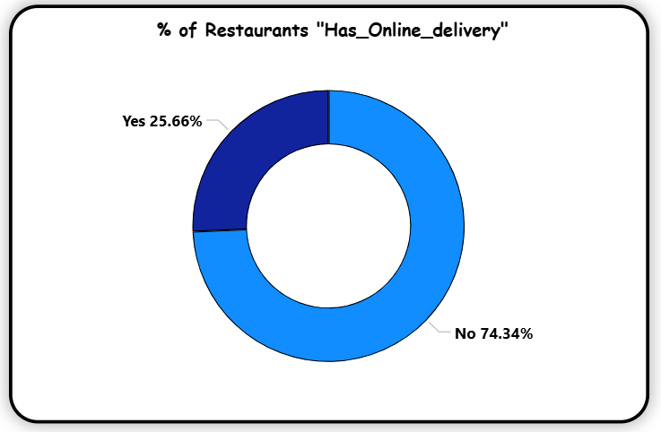

PERCENTAGE OF RESTAURANTs “Has_Online_Delivery"
Quick operational capability insight
In this Donut chart we can see the percentage of restaurants that provide online delivery services.
In which “74.34%” of restaurants “Do NOT” offer online delivery Services, where as “25.66%” of Restaurants are ”Yes” which Provide Online Delivery Services.
The larger blue portion represents “Restaurants without online delivery”, while the smaller segment indicates “Restaurants with online delivery service”.

Slide 14
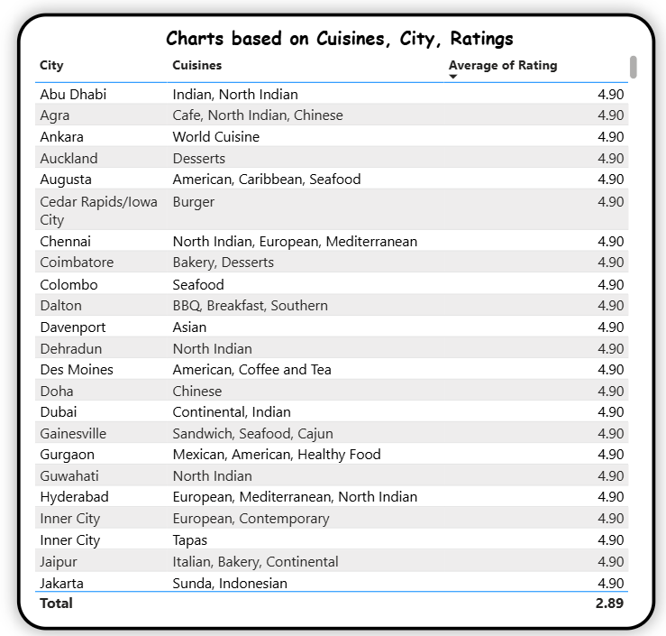

CUISINES & CITY RATINGS
Multi-cuisine dominance identified, it helps in menu & expansion strategy
This table presents the average restaurant ratings across different cities and their popular cuisines.
Each row represents a city
The Cuisines column shows commonly served cuisines in that city.
The Average of Rating column reflects the overall customer rating for restaurants in that city.
Most cities show a high and consistent average rating of around 4.9, indicating strong customer satisfaction across multiple locations and cuisines.

Slide 15

KPI’s
Total Restaurants (9,551): Indicates the overall scale of the restaurant dataset.
Total Countries (15): Shows global presence across multiple countries.
Total Cities (141): Represents wide geographic city-level coverage.
Total Cuisines (1,825): Reflects high diversity of food options.
Average Rating (2.89): Shows moderate overall customer satisfaction

Slide 16

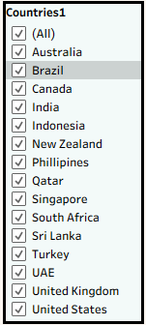
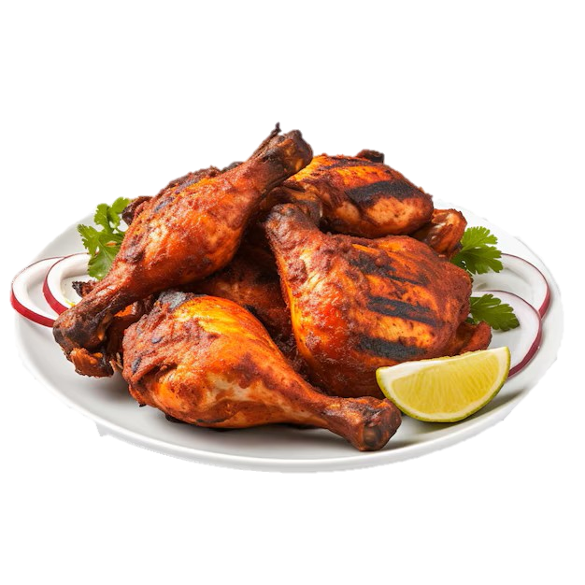
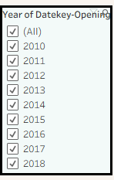
SLICERS COUNTRY & YEAR WISE
Country Slicer: Allows filtering restaurant data by selected country for regional analysis & Country-wise View Helps compare performance across different countries.
Year Slicer: Enables year-wise analysis based on restaurant opening date & Year-wise View: Tracks trends and growth over time
Combined Use: Provides flexible, focused analysis by country and year together

Slide 17

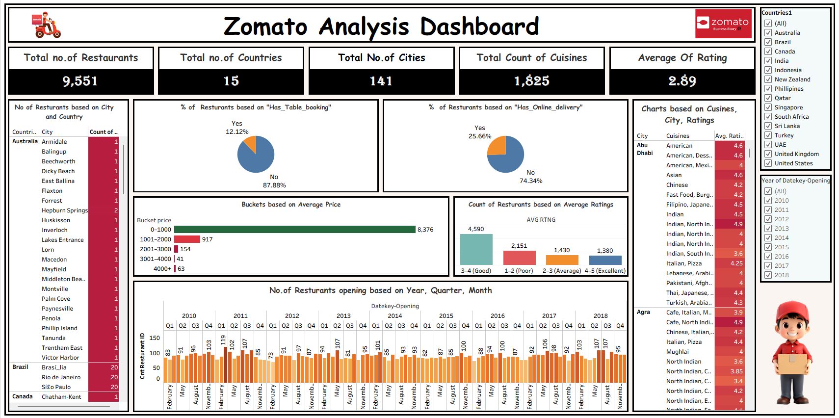
FINAL DASHBOARD - TABLEAU

Slide 18

CONCLUSION
India dominates the dataset, with New Delhi alone contributing over half of the total restaurants.
Most restaurants fall in the 0–1000 price range, showing strong presence of budget and mid-range dining.
“Great (3–4)” ratings category has the highest count, indicating generally good customer satisfaction.
Online delivery and table booking adoption is still limited, highlighting scope for digital expansion.
Multi-cuisine restaurants perform consistently well across cities, supporting diverse food preferences.
Time-based analysis reveals growth and seasonal trends, useful for strategic planning and expansion.

Slide 19




Slide 20


